Slide 1
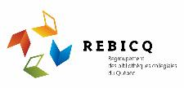
A Guide to Academic Integrity and Avoiding Plagiarism
2021

Slide 2
Vocabulary / Terminology
In English, two phrases are used to speak about honesty in academic work:
Academic integrity, and
Intellectual integrity
In this Guide, the term academic integrity was chosen as it is the most common term used in Quebec English Educational Institutions.
In French, the term l’intégrité intellectuelle is most frequently used.
Mediography: is similar to a Bibliography, in that it is “a list of multimedia materials on a given subject.”

Slide 3
Introducing the Guide
This Guide to Academic Integrity and Avoiding Plagiarism
Was created between 2018 and 2020 by the ‘Comité plagiat et intégrité intellectuelle’, which brought together ICT Pedagogical Counsellors and college Librarians.
Was developed by using many sources of information.
Has two sections:
Training for teachers
Pedagogical materials to share with students
Was translated into English in 2021.

Slide 4
Training for Teachers

Slide 5
Plagiarism in Higher Education
Plagiarism is a serious concern in higher education. All teachers may encounter cases of plagiarism or breaches of academic integrity, regardless of their discipline.
Research "estimates that 40% of university students . . . have already plagiarized in at least one assignment during their studies"⁽¹⁾. The phenomenon is therefore at a scale that cannot be ignored.
Fortier, M. (2018, December 8). Le Devoir. Clémence pour les tricheurs.

Slide 6
Plagiarism in Higher Education
Fortunately, there are possible solutions.
The first steps are to learn
About the causes of plagiarism
How you can help students develop academic integrity
How to adapt your teaching practices to prevent plagiarism
Engaging in this process will help you combat plagiarism!
Fortier, M. (2018, December 8). Le Devoir. Clémence pour les tricheurs.

Slide 7
A Hyper-Connected Student Population
It is not just an illusion: the students who are currently attending your classes are hyper-connected.
However, researchers note that being almost constantly online does not mean that students know how to use these technologies for their academic needs.
Students often use these tools superficially. They need guidance so that they can use digital tools in appropriate and effective ways.
Dahlstrom, E. & Bichsel, J. (2014, October). ECAR Study of Undergraduate Students and Information Technology, 2014. Research report. Louisville, CO. Available from http://www.educause.edu/ecar and https://library.educause.edu/~/media/files/library/2014/10/ers1406-pdf.pdf?la=en.

Slide 8
A Culture of Mixing and Remixing
It seems that the ever-present internet, and the sharing and re-sharing of information online influences the students’ view of plagiarism. The internet has fostered a culture of mixing and remixing.
Many students do not realize that this practice constitutes plagiarism.
Mixing and Remixing:
Students will search all over for different elements to integrate into their assignments, all in an attempt to create something new.
Radio-Canada. (2019, March 19). Interview with Sébastien Béland: Le plagiat à l’université. [Audio file].

Slide 9
Is plagiarizing a digital source, plagiarism?
Studies also show that students find it less dishonest to plagiarize a digital source than a paper source. Many students imagine that the internet belongs to “everyone,” feeling encouraged by the fact that some sites do not even include the author's credentials.
Misunderstandings about plagiarism arise and lead students to believe that it is not so serious. It is therefore necessary to make students aware of this issue.
Baruchson-Arbib, S. & Yaari, E. (2004). Printed versus Internet plagiarism: A study of students’ perception. International Journal of Information Ethics, 1.

Slide 10
Why do Students Plagiarize?
Videos:
DCULibrary | Dublin City University (Ireland). (2013, February 15). Why do students plagiarize?. [Video, 2:30 minutes].
Pears, R. & Shields, G. (2014, May 14). Macmillan Study Skills. Cite them right. Why do some students plagiarise? [Video, 1:40 minutes].

Slide 11
Causes of Plagiarism
Ignorance of plagiarism
Poor knowledge of the rules for referencing sources
Clumsy methodologies
Misconception that what is on the internet belongs to everyone and can be reused without permission
Difficulties in writing, weak language skills
Cultural differences
Lack of time to complete the assignment, panic
Pressure to get good results
Feeling unable to do the work on their own
Lack of interest in the work to be done
Feeling that everyone else is cheating
Perreault, N. (2018). Respecting intellectual integrity and preventing plagiarism is possible.
Université de Montréal. (n.d.). Causes du plagiat. Intégrité – Université de Montréal.

Slide 12
Going further . . .
While none of these reasons can excuse plagiarism, it is necessary, as teachers, to consider why students may breach academic integrity and teach them how to respect it.
University of Auckland (New Zealand). (n.d.). CLOM on Academic Integrity. FutureLearn. [Video, 2:35 minutes].

Slide 13
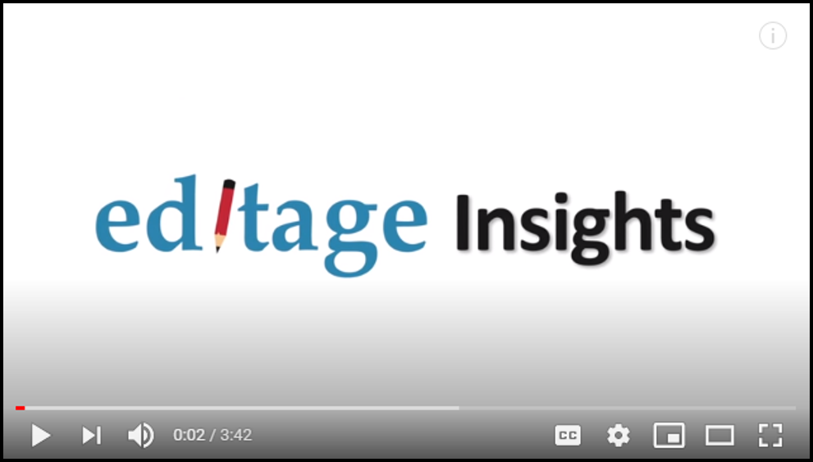
Tips to Avoid Accidental Plagiarism
Editage Insights. (2013, November 12). Tips to avoid accidental plagiarism. [Video, 3:42 minutes].

Slide 14
What Can Be Done to Develop Academic Integrity?
Not all students have the same understanding of plagiarism or the same perception of the seriousness of it, or of other breaches of academic integrity.
It is therefore important to help students understand these issues. It is a shared responsibility: teachers, technicians, the college, program, and library, information technology, and communication staff all have a role to play in preventing plagiarism.
In this matter, stakeholder consultation is essential.
However, here's what you can do to contribute to the development of academic integrity in the student population.

Slide 15
Best Practices to Develop Academic Integrity
Inform
Train
Communicate the definition of plagiarism and academic integrity
Teach students
How to insert a word-for-word quote or paraphrase in a work How to add a reference directly into a text How to write a mediography How to use a media management software...
Show examples of proper source citing
Communicate college policies
Describe the consequences
Explain the importance of academic integrity

Slide 16
Best Practices to Develop Academic Integrity (continued)
Explain
Give clear instructions and be explicit in your expectations
Specify whether the work is done individually or as a team, establishing the level of collaboration allowed
Specify the bibliographic style to use
Require the use of a guide presentation of the work
Have your students sign a non-plagiarism contract
Be a role model
Quote your sources in your teaching materials (written documents and presentations)
Talk about the importance you place on academic integrity in your own practice
Distribute bibliographies that are rigorously presented and adhere to a style guide
If you want your students to adopt good habits related to academic integrity, you have to show them that you use them yourself!

Slide 17
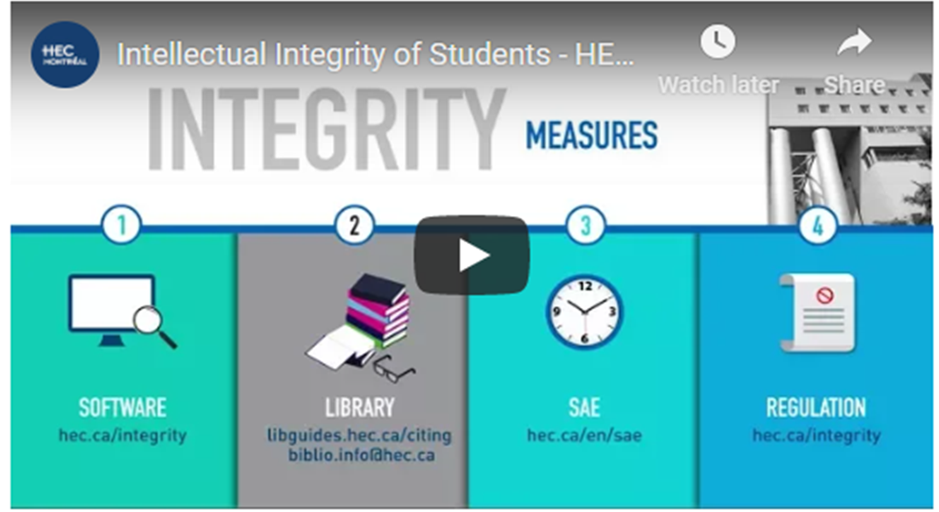
Going further . . .
HEC Montreal. (n.d.). Intellectual integrity of students. [Video, 1:59 minutes].

Slide 18
Raising Awareness of Academic Integrity
Explain
Teach
Peer-to-peer tutoring
Debate, persuade, critique
Ask students to explain their personal understanding of certain concepts related to academic integrity
Ask students to teach their peers about specific notions of academic integrity
Ask students to tutor each other on academic integrity concepts
Organize team or group debates to get students to persuade peers of their views on academic integrity and learn to properly critique their peers on the subject

Slide 19
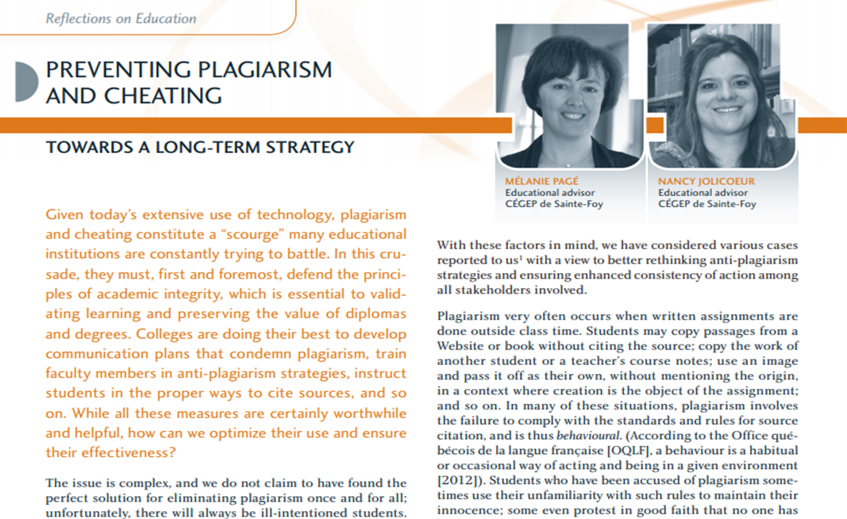
Going further . . .
Pagé, M. & Jolicoeur, N. (2015). Preventing plagiarism and cheating: Towards a long-term strategy. Pédagogie collégiale, 28(3), 1-5.

Slide 20
Prevent Plagiarism Before It Occurs
Reviewing your assessment practices remains among the most effective ways to address plagiarism in the classroom.
When reviewing your evaluation practices, first consider the three dimensions to be evaluated:
Route
Reflection
Results
Perreault, N. (2016). Stratégies de prévention du plagiat.

Slide 21
Review the Route
This is the learning route (the methods, errors, attempts, solutions, and/or corrections) the process students follow to create a final result. The teacher can require specific evidence of this route in order to review it throughout the evaluation period. This will allow the teacher to assess the progress and confirm that the final result corresponds to real development. The learning route is unique to the student and is much more difficult to plagiarize.
In practice, dividing the work into progressive steps, providing the evaluation criteria (marking rubric) and requiring evidence (e.g. portfolio, notes, logbook, progress report, sketches, first drafts, etc.) allows the route to be evaluated and thus reduces the risk of plagiarism.
Côté, F. (2014). Evaluating Attitudes: Tools for More Objective Assessment. Pédagogie collégiale, 29(3), 42-47.

Slide 22
Review the Results
The result is a concrete finished product: the realisation of a complex task.
It can take different forms (audio recording, video, mental or conceptual map, game, poster, drawing, mock-up, etc.). The formats do not have to be exactly the same for each person, provided that the task and the result prove that the person developed the competency.
However, the evaluation criteria will remain the same, which ensures equity and validity in the evaluation. Designing a product that allows the student to express themselves in a unique way can reduce plagiarism among peers.
Students must demonstrate their attainment of a competency by drawing on resources to perform a complex task. When only the results are assessed, we limit our assessment to a single performance that may be affected by end-of-term stress and fatigue.
Côté, F. (2014). Evaluating Attitudes: Tools for More Objective Assessment. Pédagogie collégiale, 29(3), 42-47.

Slide 23
Review the Reflection
A student who is able to correctly explain and justify, or question, their choices demonstrates their competence. They are then able to clarify their strengths and weaknesses both in their approach and in their results. This may be formal (text or responses to direct questions) or informal (oral or self-assessment). This is unique to the learning process and cannot be plagiarized.
For this reason, it is recommended that assessment include, the route, the results, and, when relevant, the reflection.
Côté, F. (2014). Evaluating Attitudes: Tools for More Objective Assessment. Pédagogie collégiale, 29(3), 42-47.

Slide 24
Principles of Authentic Assessment
Tasks present a challenge for the student
Tasks lead to a product and/or a performance
Tasks allow the student to develop metacognitive skills
Tasks lead to an authentic product that represents what exists in a professional environment or in everyday life
Tasks include opportunities for discussion and feedback with the student, alone or in teams
Propose tasks that respect the principles of authentic assessment
Leroux, J. L., Groupe de recherche en évaluation des apprentissages au collégial et Association québécoise de pédagogie collégiale (dir.). (2015). Évaluer les compétences au collégial et à l’université: un guide pratique. Montréal: Association québécoise de pédagogie collégiale (AQPC).

Slide 25
Modify the Terms, Conditions, or Formats of Evaluations
Vary the assignment topics
Require self-
reflection
Require an oral presentation in which the student explains their route, their results, and their reflections
Require an annotated bibliography of
cited texts
Require a signed academic integrity contract
Write clear instructions, provide criteria and an evaluation grid, and provide examples that illustrate what the product could look like
Evaluate source referencing (much as you evaluate for written expression or organization)
Require that work be submitted in digital form when appropriate for easier verification of sources and citations (or lack thereof).
Inform students that you
use plagiarism detection
software (and use it!)
Ask your college library to give a student workshop on quoting sources, writing a bibliography, or on the use of reference management software, such as Zotero.

Slide 26
Pedagogical materials to share with students

Slide 27
What is Academic Integrity?
To show academic integrity is to act properly and to behave ethically.
Academic integrity is based on five key values:
Justice
Honesty
Trust
Responsibility
Respect

Slide 28
Questions to Ask
A student who correctly cites their sources, who refrains from cheating and who does their work honestly meets the standards of academic integrity.
It is not always easy to know if a behaviour is honest or not. To help students, encourage them to ask themselves some questions:
Is what I want to do allowed?
Does this give me an advantage that others do not have?
Would my family and friends, my teacher, or even a future employer react well if they found out what I did?
Can I reuse work that I have already submitted in another course? (Probably not). Can I ask a classmate to help me write my assignment when the instruction is to do it individually? (No)

Slide 29
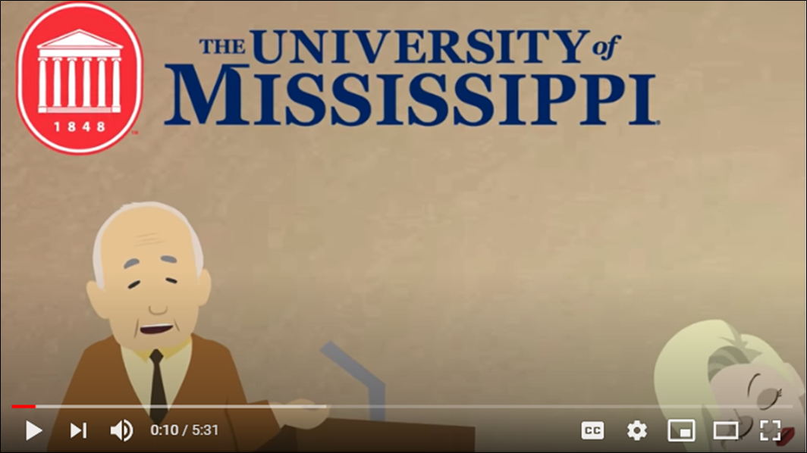
Going further . . .
University of Mississippi Libraries. (2015, August 20). Plagiarism Tutorial. [Video, 5:31 minutes].

Slide 30
Going further . . .
University of Victoria, BC. (2016, March 2). Academic integrity and avoiding plagiarism. [Video, 2:38 minutes]
HEC Montréal. (n.d.). Intellectual integrity of students.
International Center for Academic Integrity. (2014). The fundamental values of academic integrity. (2nd ed.). [Downloadable Booklet].

Slide 31
What do I gain from being honest?
You gain skills that will be useful in your personal and professional life.
Your teachers notice that you have integrity and this contributes to good grades.
You get results you are proud of, because you deserve them.
You avoid a zero or the nullification of your assignment.
You help to guarantee the value of a diploma (including yours!).

Slide 32
Going further . . .
D'Annunzio, M. H., (2013, June 14). TED-Ed. The Punishable Perils of Plagiarism. [Video, 3:47 minutes]

Slide 33
In college . . .
In college, you learn to develop your thinking, analyze information, express your ideas, and argue. To do this, it is fine, even necessary, to rely on what others have said, written, or produced before you, if you cite your sources.
Teachers expect your work to be based on, and inspired by, existing sources that you cite, while respecting the instructions they have given. Remember to include your own analysis when instructed to do so, as this will show what you have understood the topic.
If you are unclear about what to do on an assignment, please consult your teacher for more information.

Slide 34
Why consult sources of information for your work?
In most cases, conducting research requires consulting a variety of documents (websites, books, journal articles, etc.).
This first step allows you to
Learn more about the subject matter of your work, to refer you to experts to better understand the issues at stake
Obtain different points of view on this subject, to feed your reflection and analysis, and also to form your own judgment
Select the most interesting, relevant and reliable information in the documents consulted and to use them in your writing

Slide 35
And that brings us to the citations!
Citing sources in your work is a good thing!
They show that you have taken the time to do research and that you have taken your work seriously.
By using well-chosen references, you add strength to your analyses by showing that they are supported by expert writings and/or theories.
You show respect for the authors who informed your work.
You avoid plagiarism!

Slide 36
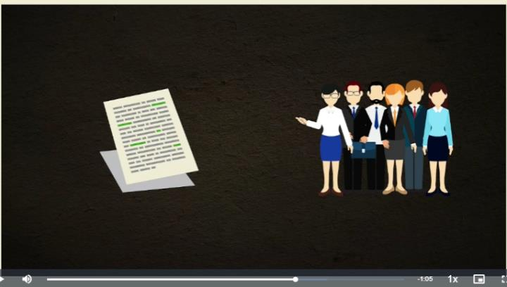
Going further . . .
Info Track. Training for Information Literacy. How to make sure you don’t plagiarize. [Downloadable video with English subtitles, 3:38 minutes].

Slide 37
Collaboration: Be Careful!
As part of your studies, you will sometimes have to work in teams. Learning to work in a team is important because you will have to work with many people in your professional life.
But working in a team requires attention to certain things. Since the outcome of the assessment is likely to be similar for all team members, you need to make sure that each member understands and agrees to follow instructions. You are all responsible for the content of the work and if one of you makes a mistake (for example, plagiarizes), you may all be penalized.
At other times, your teacher will ask you to work individually. And there are limits to what you can offer or receive as assistance. Your work and that of your classmates must be different, personal.
If you have any questions about what is or is not allowed for an assignment, it is strongly suggested that you consult your teacher.

Slide 38
What is plagiarism?
Plagiarism is implying, intentionally or unintentionally, that you had someone else's original idea or way of expressing an idea.
More precisely, plagiarism is the act of passing off as your own, intentionally or unintentionally, part or all of a text, production, or idea of another person. Whenever we use what someone else has said, written or produced, without citing the source, it is plagiarism. The only way to avoid plagiarism is to correctly cite your sources, according to the standards prescribed by your teacher, your college, and your program of study.

Slide 39
Be aware that you are plagiarizing when you do the following without citing your sources...
Copy a text word-for-word, or simply ‘copy and paste’​
Borrow words or phrases from elsewhere, change a few words only and integrate the passage into your work
Reformulate an idea or theory in its entirety
Translate a text or a speech and integrate it into your work
Copy an image, a graphic, or data​
Incorporate into your work, music or a video from somewhere else ​
Repeat or summarize someone's words or ideas, without mentioning that person
Copy, borrow, reformulate, translate, repeat, or summarize without citing your work properly

Slide 40
Getting Help
Plagiarism does not go unnoticed. Whether through lack of knowledge, ignorance of the rules for citing sources and creating a mediography, or lack of time, none of these reasons can justify plagiarism.
You are responsible for respecting intellectual property and knowing the standards for assignments.
Fortunately, there are many ways to get help!
The guide you are currently viewing is designed to give you access to several resources.
Your teachers, library, computer support, and student services at your college may also be able to assist you.
If you have a problem, don't hesitate to ask for help!

Slide 41
In Practice: Getting Off to a Good Start
When you are asked to write a lengthy piece of work, either individually or as part of a team, it is recommended that you follow a few steps before you start writing:
1
2
3
Plan your time. There are tools available to help you prepare your work schedule. It will save you the stress of having to finish everything just before the due date.
Take notes as you search for information. At this stage, it is very important to record the reference of each source you consult, including
Keep and organize all your references in one place. Media management software such as Zotero or EndNote are very helpful. These apps prevent you from losing references and ensure that you keep a record of everything. During the writing process, they also allow you to add your references directly into your work and to create your bibliography or mediography. These useful tools will save you time, but they are not magic! You will still need to verify that your references are complete and appropriately cited before submitting your work.
The name of the author(s) The title of the document The publication information (year, place of publication/publishing house or website address)

Slide 42
Going further . . .
Plan Your Time:
University of Minnesota Libraries. (n.d.).
Assignment Calculator.
Planifier l’échéancier de ma recherche.
For Annotation:
CCDMD. (n.d.). Marking up and annotating digital documents. [Video, 5:38 minutes].
CCDMD. (n.d.). Documenting data, facts, observations, concepts, ideas or reflections. [Video, 6:25 minutes].
Zotero:
Zotero is a downloadable, free, easy-to-use tool to help you collect, organize, cite, and share research.
EndNote:
EndNote is a commercial reference management software package, used to manage bibliographies and references when writing essays and articles.

Slide 43
Citation: Where, When, and How?
If you add something to your work that you have borrowed from somewhere else, you must cite your sources.
Regardless of type (book, magazine article, report, video...), format (paper, digital, Web, CD, DVD...) and language (French, English, Spanish...) you must cite your sources.
In all cases, when you borrow something, you must cite it!

Slide 44
Exception
The only situation where it is not necessary to cite a source is when information is “common knowledge.” This means that the information is known to the majority of people and can be found in many sources. Here are some examples of information that is common public knowledge and does not need a source:
William Shakespeare is an English author.
The Second World War took place from 1939 to 1945.
Under normal conditions, water freezes at 0°C.
If you are not sure if a piece of information is common knowledge, don't take any chances: cite the source and/or consult your teacher.

Slide 45
Where to cite?
It is important to know that you must indicate your sources in two places:
How to cite?
Do APA, Chicago, or MLA ring a bell? These are citation styles. Depending on the style, the way you write your references will change. However, regardless of the citation style, the following information should be provided:
Depending on the type of document to be cited and the citation style you use, other information may be added. Don't forget to check!
In-text citation: directly in the text where the source is used References, bibliography, or mediography: the list of sources cited that must appear at the end of your work
The name of the author(s) The title of the document The publication information (year, publishing house, place of publication, website address, etc.) The page number(s) (if they exist)

Slide 46
Selection of Resources that Show You How to Cite
Brown University Library. (n.d.). How to format a citation.
Concordia University Library. (n.d.). How to cite . . ..
McGill University Library. (n.d.). Citation guides.
Purdue University, Illinois. (n.d.). Purdue OWL. How to reference in APA, Chicago, or MLA styles.
Vanier College Learning Commons. (n.d.). Referencing & citing your sources.

Slide 47
Cégep Marie-Victorin. (n.d.). Is my assignment ready to be submitted?.

Slide 48
Is My Assignment Ready To Be submitted?
Before printing or submitting your assignment, it is a good idea to check that you have respected all the principles of academic integrity and that you have properly cited all your sources.
The decision support tool "Is My Assignment Ready To Be Submitted?” asks you 5 essential questions to ensure that your work is compliant.
Have you answered the 5 questions and were you able to validate that your work was done correctly? Congratulations! Your assignment is now ready to submit to your teacher!

Slide 49
References
Baruchson-Arbib, S. & Yaari, E. (2004). Printed versus internet plagiarism: A study of students’ perception. International Journal of Information Ethics, 1.
Brown University Library. (n.d.). How to format a citation.
CCDMD. (n.d.). Marking up and annotating digital documents. [Video, 5:38 minutes].
CCDMD. (n.d.). Documenting data, facts, observations, concepts, ideas or reflections. [Video, 6:25 minutes].
Cégep Marie-Victorin. (n.d.). Is my assignment ready to be submitted?.
Concordia University Library. (n.d.). How to cite . . ..
Côté, F. (2014). Evaluating attitudes: Tools for more objective assessment. Pédagogie collégiale, 29(3), 42-47.

Slide 50
References
Dahlstrom, E. & Bichsel, J. (2014, October). ECAR Study of Undergraduate Students and Information Technology, 2014. Research report. Louisville, CO. Available from http://www.educause.edu/ecar and https://library.educause.edu/~/media/files/library/2014/10/ers1406-pdf.pdf?la=en.
D'Annunzio, M. H., (2013, June 14). TED-Ed. The punishable perils of plagiarism. [Video, 3:47 minutes].
DCULibrary | Dublin City University (Ireland). (2013, February 15). Why do students plagiarize?. [Video, 2:30 minutes].
EndNote.
Editage Insights. (2013, November 12). Tips to avoid accidental plagiarism. [Video, 3:42 minutes].
Fortier, M. (2018, December 8). Le Devoir. Clémence pour les tricheurs.
HEC Montreal. (n.d.). Academic Violations.

Slide 51
References
HEC Montreal. (n.d.). Intellectual integrity of students. [Video, 1:59 minutes].
Info Track. Training for Information Literacy. (n.d). How to make sure you don’t plagiarize.
International Center for Academic Integrity. (2014). The fundamental values of academic integrity. (2nd ed.). [Downloadable Booklet].
Leroux, J. L., Groupe de recherche en évaluation des apprentissages au collégial et Association québécoise de pédagogie collégiale (dir.). (2015). Évaluer les compétences au collégial et à l’université: Un guide pratique. Montréal: Association québécoise de pédagogie collégiale (AQPC).
McGill University Library. (n.d.). Citation guides.
Merriam-Webster. (n.d.). Mediography. In Merriam-Webster.com dictionary.
Pagé, M. & Jolicoeur, N. (2015). Preventing plagiarism and cheating: Towards a long-term strategy. Pédagogie collégiale, 28(3), 1-5.

Slide 52
References
Pears, R. & Shields, G. (2014, May 14). Macmillan Study Skills. Cite them right. Why do some students plagiarise? [Video, 1:40 minutes].
Perreault, N. (2016). Stratégies de prévention du plagiat.
Perreault, N. (2018). Respecting intellectual integrity and preventing plagiarism is possible.
Purdue University, Illinois. (n.d.). Purdue OWL. How to reference in APA, Chicago, or MLA styles.
Radio-Canada. (2019, March 19). Interview with Sébastien Béland: Le plagiat à l’université. [Audio file].
Stony Brook University | Libraries, New York. (n.d.). Citations & plagiarism: Avoid plagiarism.
Université de Montréal. (n.d.). Causes du plagiat. Intégrité – Université de Montréal.
University of Auckland (New Zealand). (n.d.). CLOM on Academic Integrity. FutureLearn. [Video, 2:35 minutes].
University of Minnesota Libraries. (n.d.). Assignment Calculator.

Slide 53
References
University of Minnesota Libraries. (n.d.). Planifier l’échéancier de ma recherche.
University of Mississippi Libraries. (2015, August 20). Plagiarism Tutorial. [Video, 5:31 minutes].
University of Victoria, BC. (2016, March 2). Academic integrity and avoiding plagiarism. [Video, 2:38 minutes].
Vanier College Learning Commons. (n.d.). Referencing & Citing your Sources.
Zotero.

Slide 54
This document was produced by the ‘Comité plagiat et intégrité intellectuelle’, which includes members of the REPTIC Network and the Regroupement des bibliothèques collégiales du Québec.
This document was revised and translated into English by EDU-PRO in 2021
2021

